Slide 1
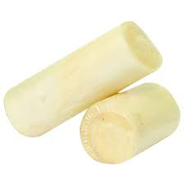
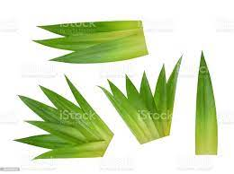
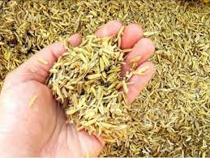
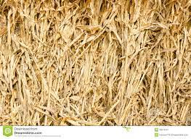
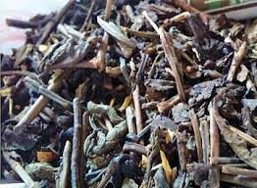
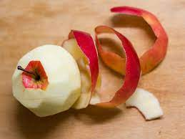
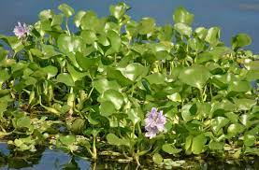
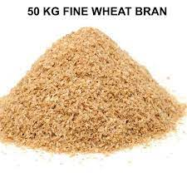
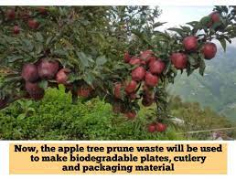
FLUSHING
BIOMASS RAW MATERIAL CHOICES & MANY MORE
Rice Husk
Banana stem
Pineapple leaves
Tea waste
Corn straw
Apple peel
Water hycinth
Wheat Bran
REECON Aqua Green Technologies Private Limited

Slide 2
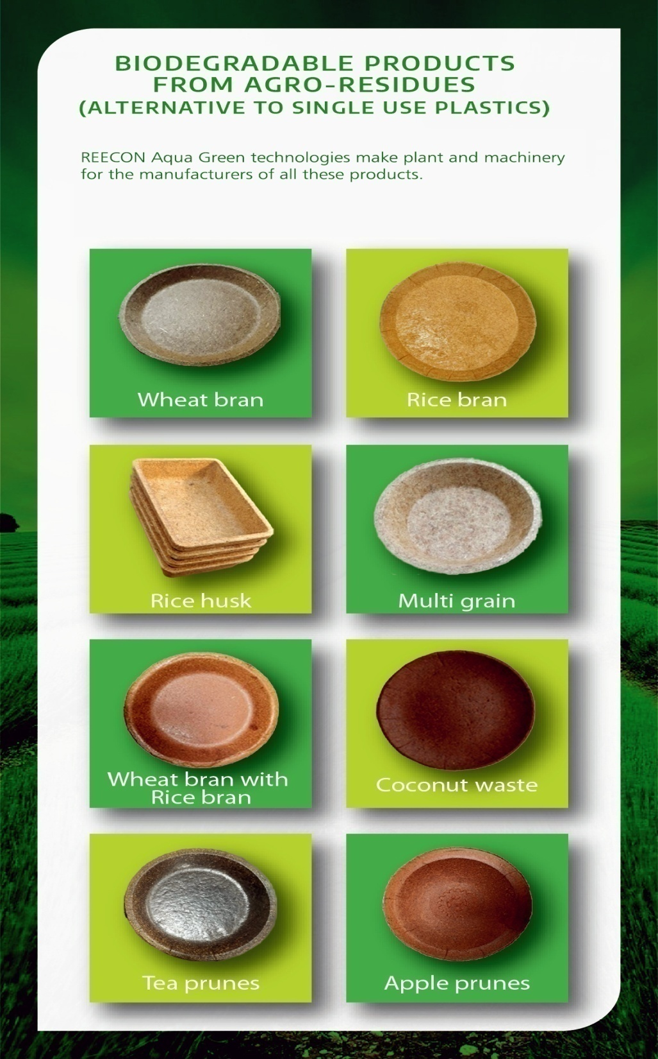
FLUSHING
tTcdcow5
RAW MATERIAL SELECTION OPTION FROM DIFFERENT AGRO RESIDUES

