Slide 2
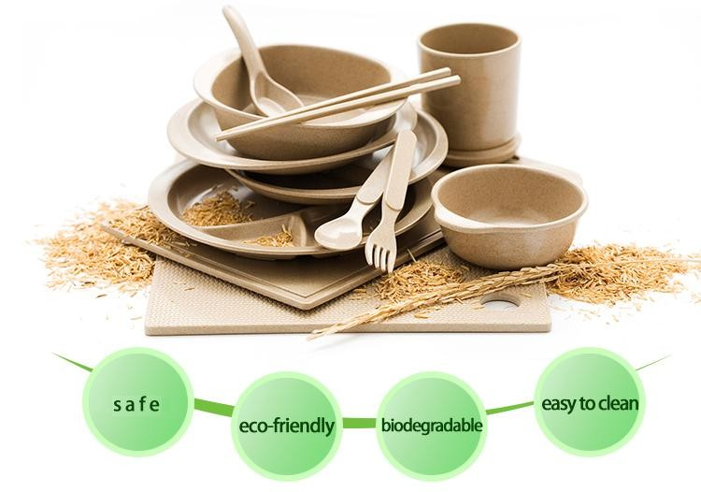

Slide 3
Introduction :
Vemuri Agri Products (VAP) is a Sister concern of Propac Engineers with extensive experience across diverse industries specializing in the Supply of Machinery for Processing of Agri Waste into sustainable livelihood projects. VAP serves as a complete solution provider with End to End Solutions dedicated to crafting environmentally Eco friendly, easily compostable, Biodegradable daily use products from Agricultural fibre /waste like Areca Nut Leaves /Coconut Coir / Banana Fibre, Rice Husk / Date palm Fiber / Pineapple Fiber etc. An ideal alternate to Plastic Cutlery.
Rice husk tableware is a durable sort of biodegradable cutlery that can withstand temperature upto 80 C without getting damaged. It features a smooth glossy covering that's 100% natural and derived from the wax present in rice husks such as cups, plates, spoons, bowls being biodegradable provide more convenience and easy to dispose after use while on vacations, family outings and functions.
Our machines operate on Hydraulic Press system to create different articles as per the shape of the dies made in GMP standards as per the client requirement. The latest alloy technology is used to get a smooth finish and all the final products are of proven Food grade standards and fit to be used for serving food. They are Bacteria, Fungus resistant and are Microwave friendly.
.

Slide 4
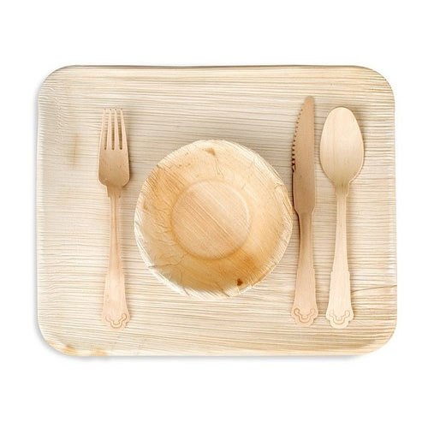
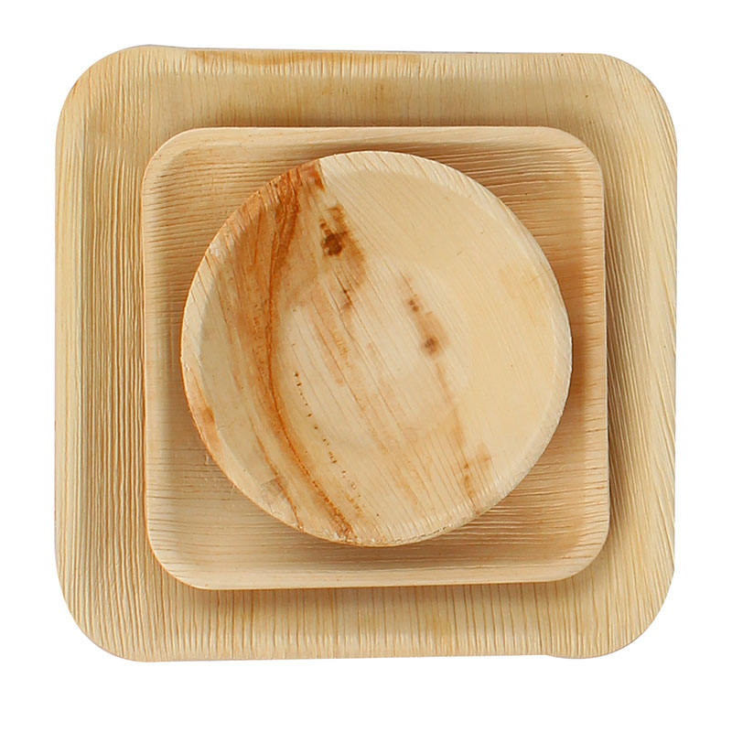
Areca Leaf made
Eco-friendly disposable plates made from fallen areca palm leaves, a sustainable alternative to plastic.

Slide 5
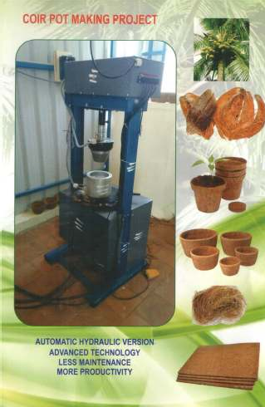

Slide 6
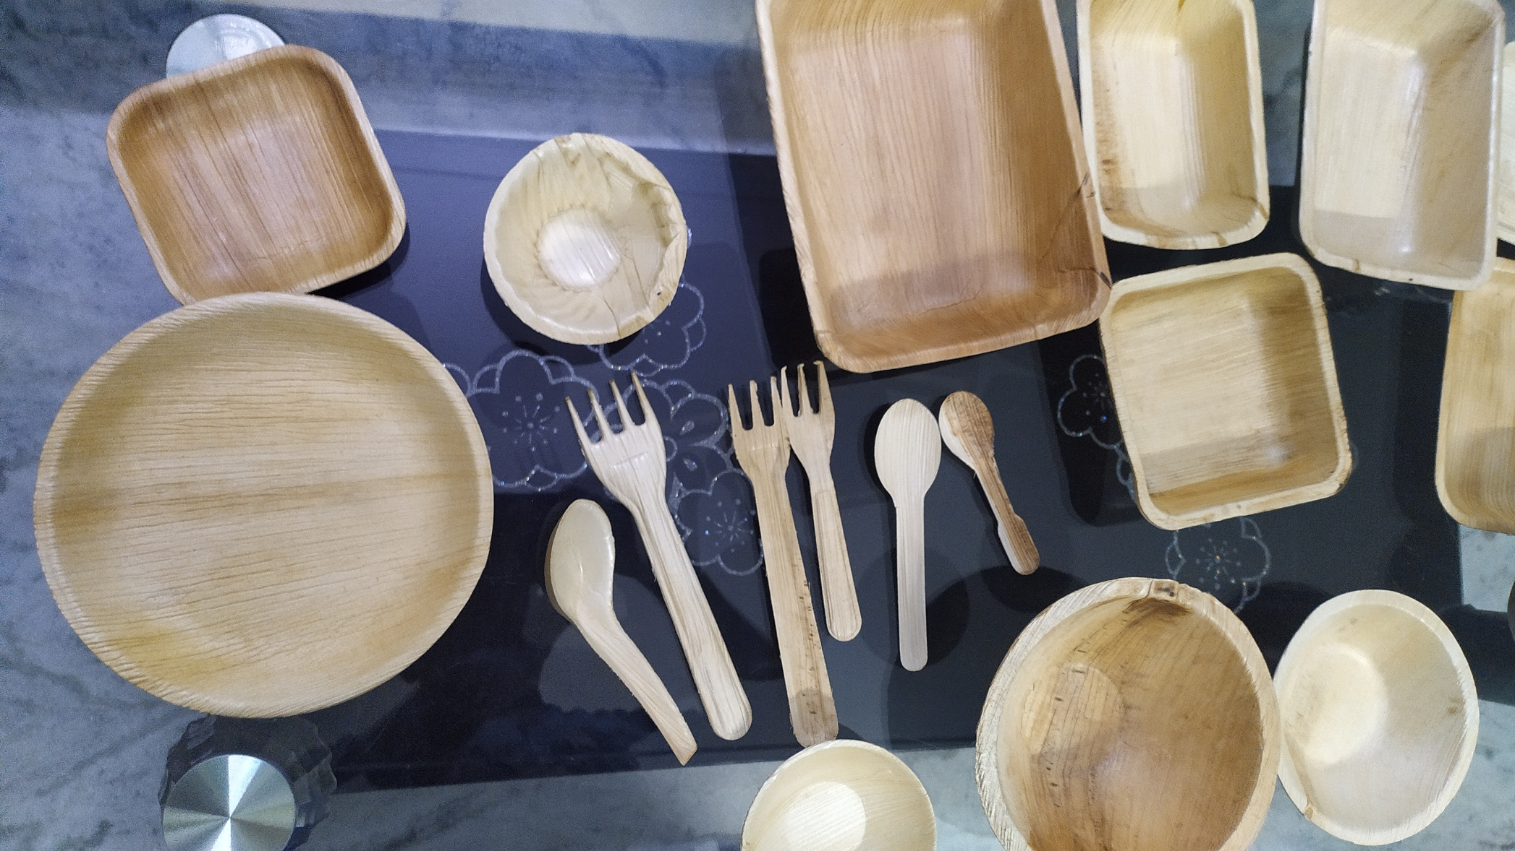

Slide 7
Plan of Action :
1. Research and Development: This phase will involve researching and developing a process to create cutlery from rice husks / bran. This will include experimenting with different techniques and materials to determine the most cost efficient process.
2. Prototype Development: Once the process has been developed, the team will create prototypes of the cutlery to test their durability, functionality, and aesthetic appeal.
3. Testing: The prototypes will be tested in different environments to ensure that they can withstand regular use and cleaning.
4. Production: The production process will be optimized to ensure that the cutlery is cost-effective and scalable. Though they are not designed for multiple uses, the cutlery can be reused if utilized for dry food items.
Contd

Slide 8
Plan of Action – Part II
1) Develop a process to create Eco friendly biodegradable easily compostable cutlery from Agriculture waste like Banana Fiber / Rice husk / Jute Fiber / Coconut Fiber.
2) Cutlery that is functional, and aesthetically pleasing.
3) Raise awareness about the benefits of a circular economy.
Timeline : Research and Development - 2 months
2) Prototype Development and Testing - 3 months (Approx)
3) Final Testing - 1 month
4) Production - 6 months.

Slide 9
Crafting with Banana Fiber

Slide 11
STUDIES CONDUCTED ON THE FINAL FINISHED PRODUCTS :
Biodegradable Test (ISO145855-2:2018) and eco-toxicity analysis
(ASTMD3987-12)
Shelf-life studies (yeast, mold, fungi) (ISO16779:2015)
Toxicology studies (in-vitro and in-vivo)
Water retention and heat retention test
Wetting studies (contact angle goniometry, water & oil)
Mechanical properties of finished product (ISO13061-5:2020)
Leakage proof, bursting and tearing properties
Sensory properties of food packed in the developed container at
different conditions (ISO 16779:2015)

Slide 12
Biodegradable cutlery from Egyptian Rice Husk.

Slide 13
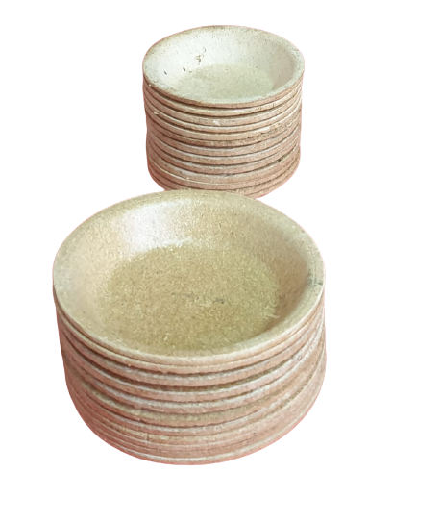
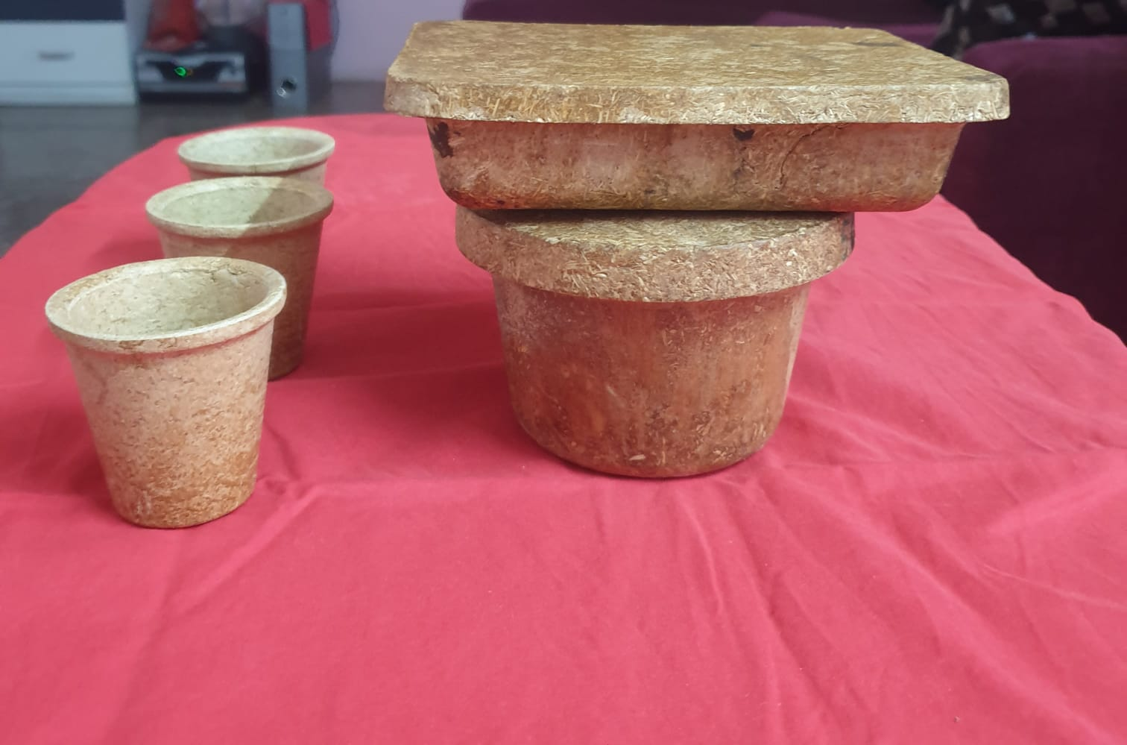
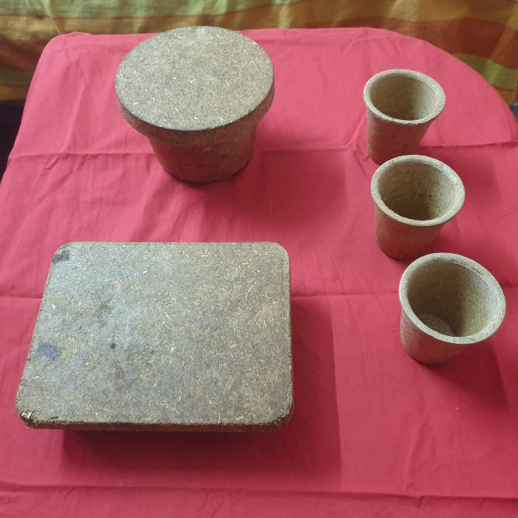
Cutlery made from Rice Husk
Rice husk cutlery can be used, such as in picnics, catering, and Barbeque events.
Highlight that rice husk cutlery can be customized with different colors and shapes to fit specific needs.
Some of the samples.

Slide 14
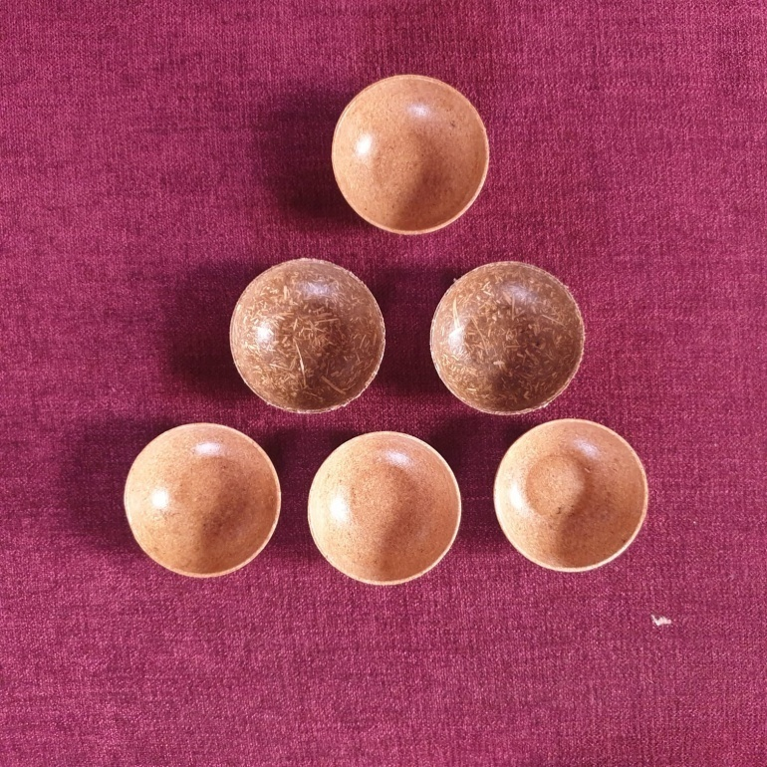
Products – Bowls made from Rice Husk

Slide 15
From Rice Husk

Slide 16
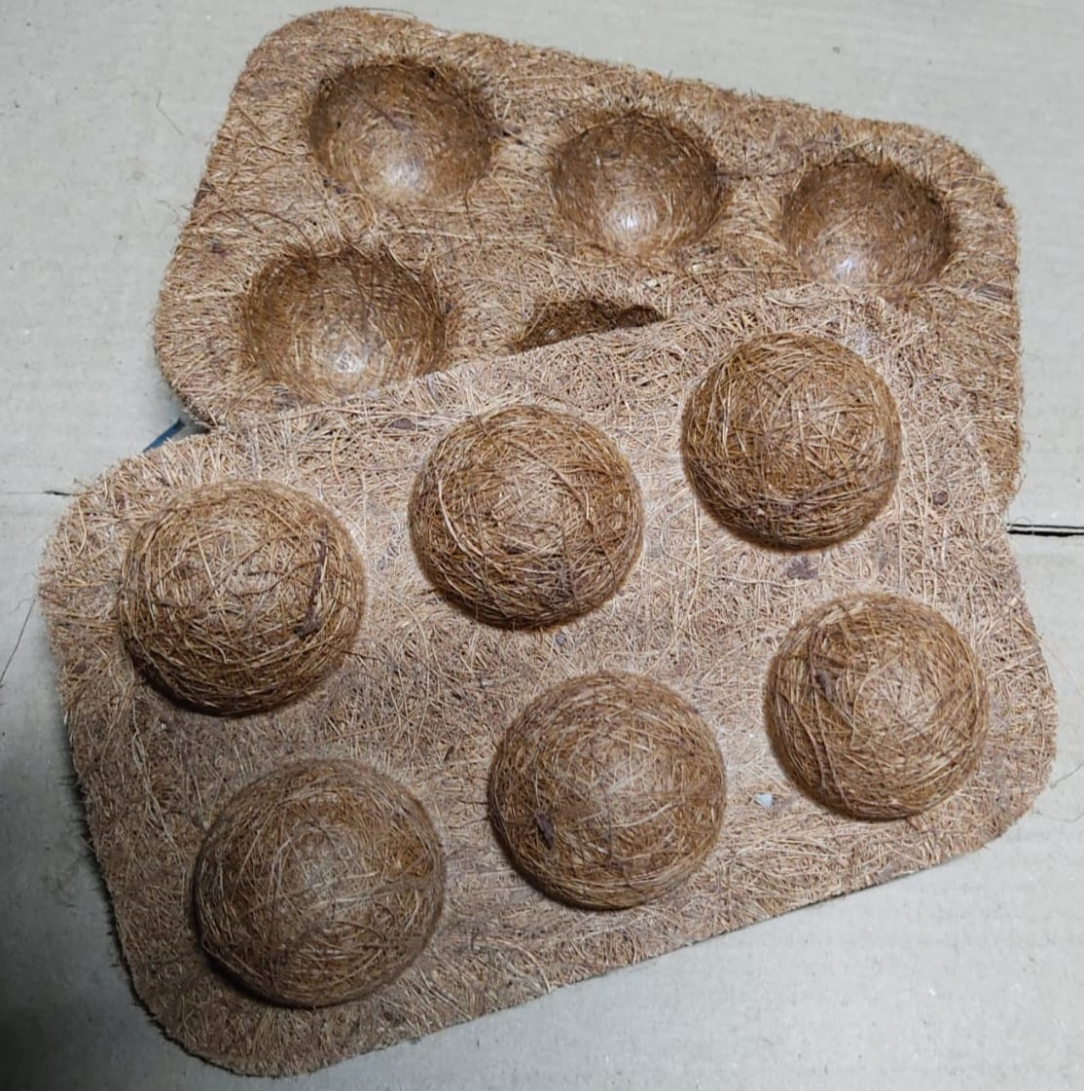
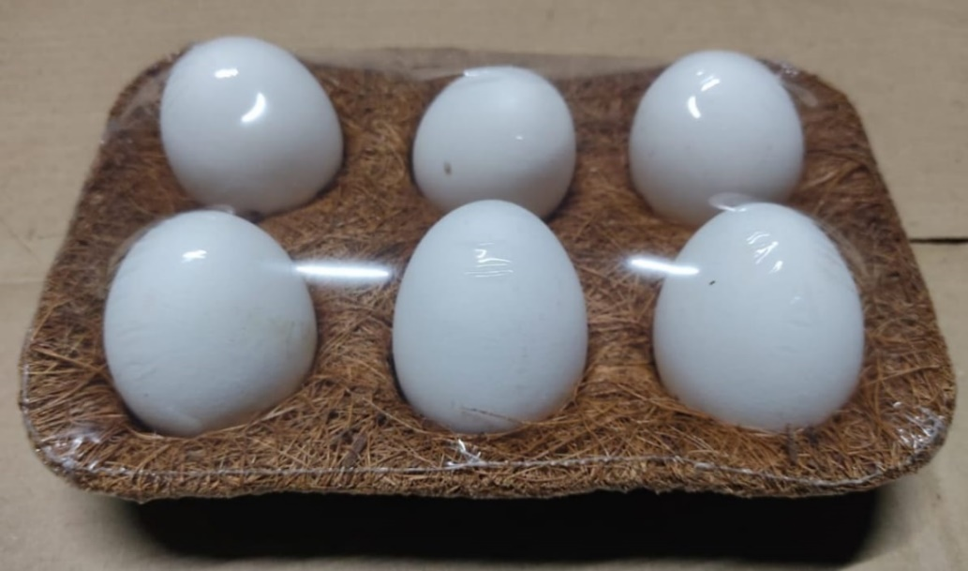
Egg tray made from Coconut / Jute fibre

Slide 17
Eating Plates made from Rice Husk

Slide 18
Summary :
The methodology has been developed through inputs from our experience of implementing different strategic and technology solutions . We continuously incorporate global best practices and emerging trends to ensure that our methodology remains pertinent to the present and future circumstances. At Vemuri Agri Products, our solutions for up-cycling of the agri waste and transforming it, into eco-friendly sustainable and disposable plates, bowls, tumblers and more is part of the Circular Economy.
We would be happy to provide the required complete range of machinery and technology transfer to set up Small or Medium Type project to make the different products as given in this presentation
To provide a more detailed selection, please provide the following details
Type of Agri Waste / Natural Fiber available (Wet or Dry)
Quantity of Fibre available per day. – Capacity calculation.
Type of products interested in manufacturing.

Slide 19
CONTACT US
Website: www.vemuriagriproducts.com
Email – info@vemuriagriproducts.com
Mob - +91 9394742416 +91 6303980190
+91 7994127122
Corporate Address: 6-3-630/1,2&3,Ram Sai Symphony Dwellings
Flat # 36, Anandnagar Khairthabad
Hyderabad Telangana 500004,
INDIA

Slide 20
THANK YOU

