Slide 1


Slide 2
A Brief Presentation on Visakha CFS & Logistics Ltd., Visakhapatnam

Slide 3
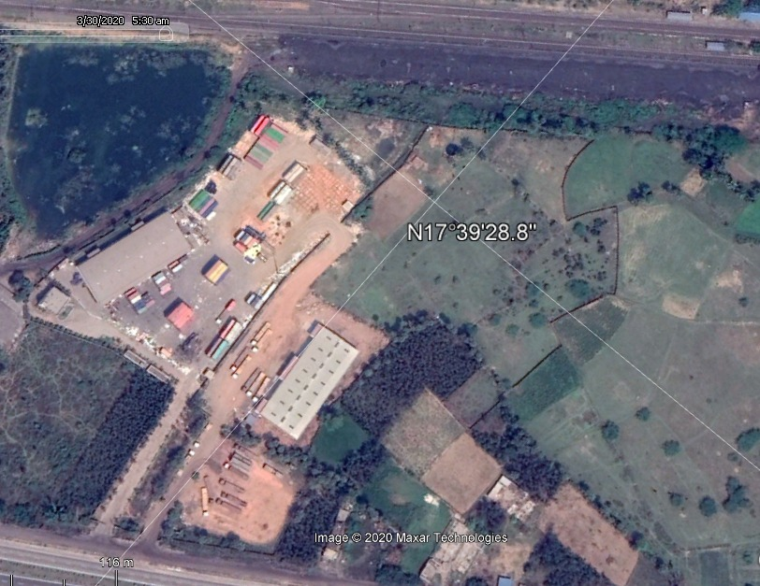
Aerial View of Visakha CFS

Slide 4
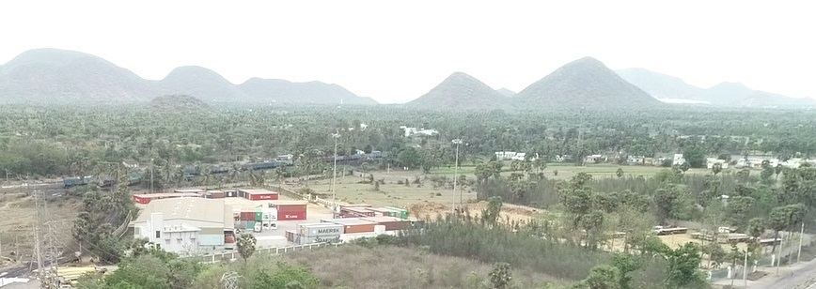

Slide 5
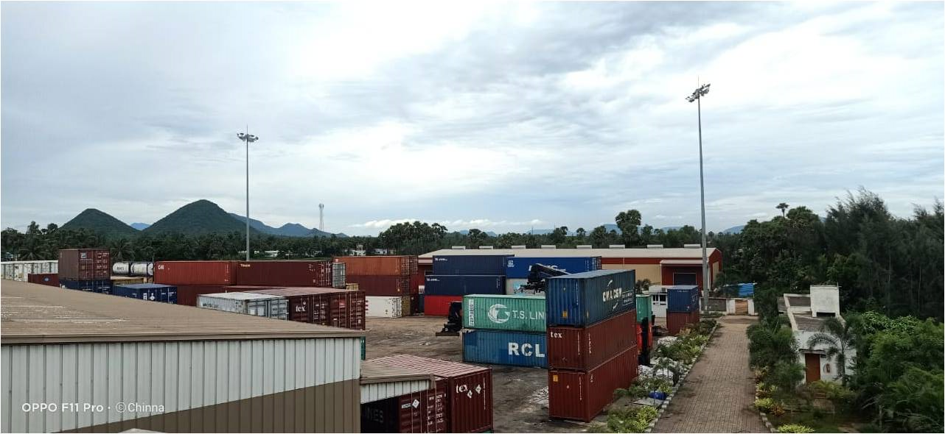

Slide 6
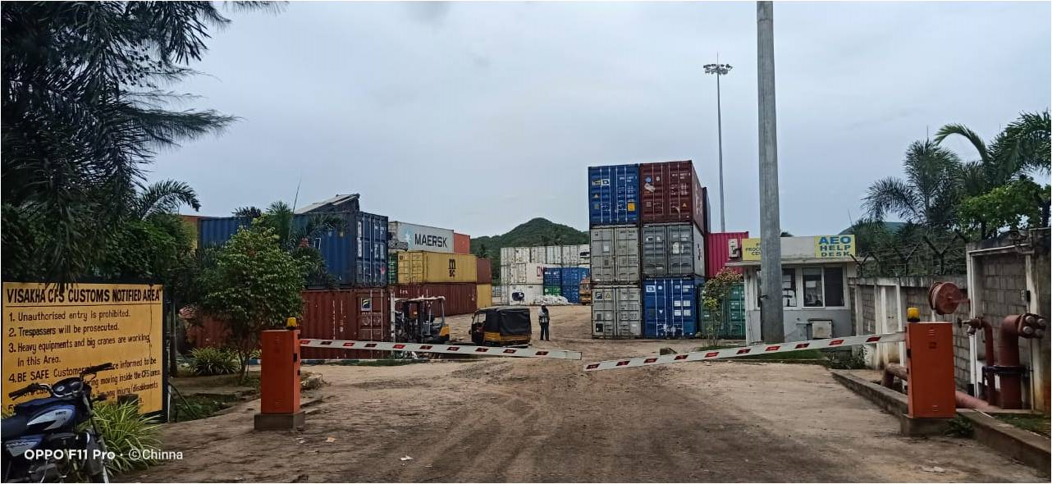

Slide 7
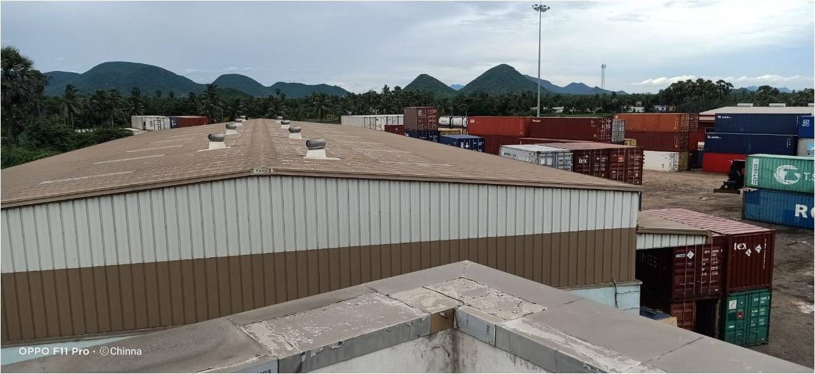

Slide 8
Various Cargoes Handled by VISAKHA CFS

Slide 9
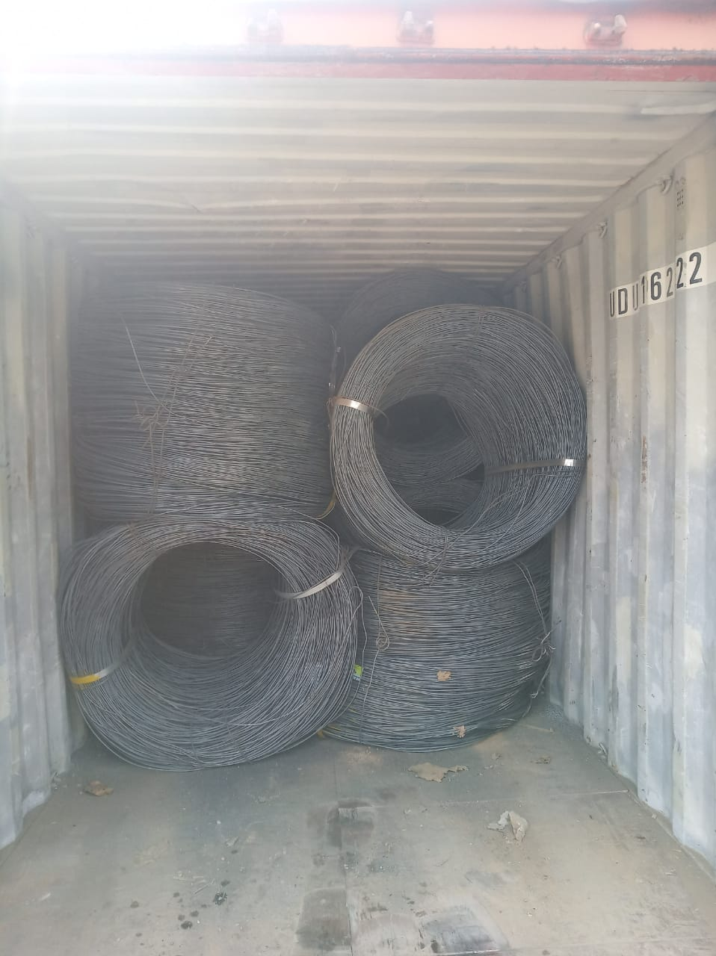
STEEL WIRE ROD COILS

Slide 10
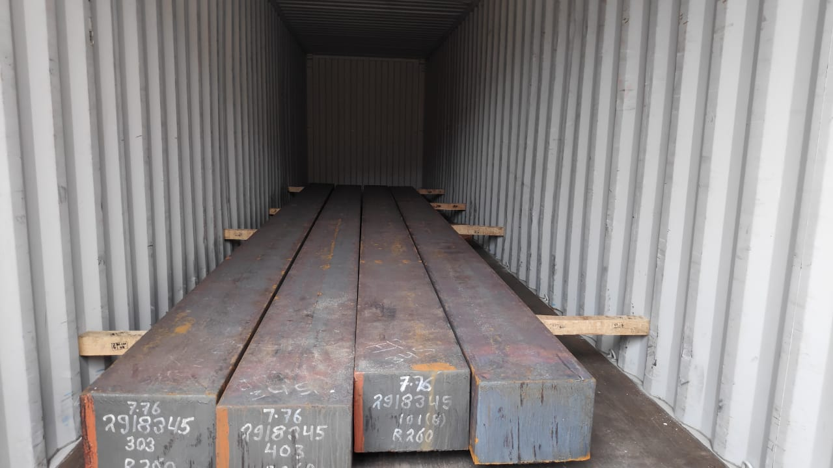
STEEL BILLETS

Slide 11
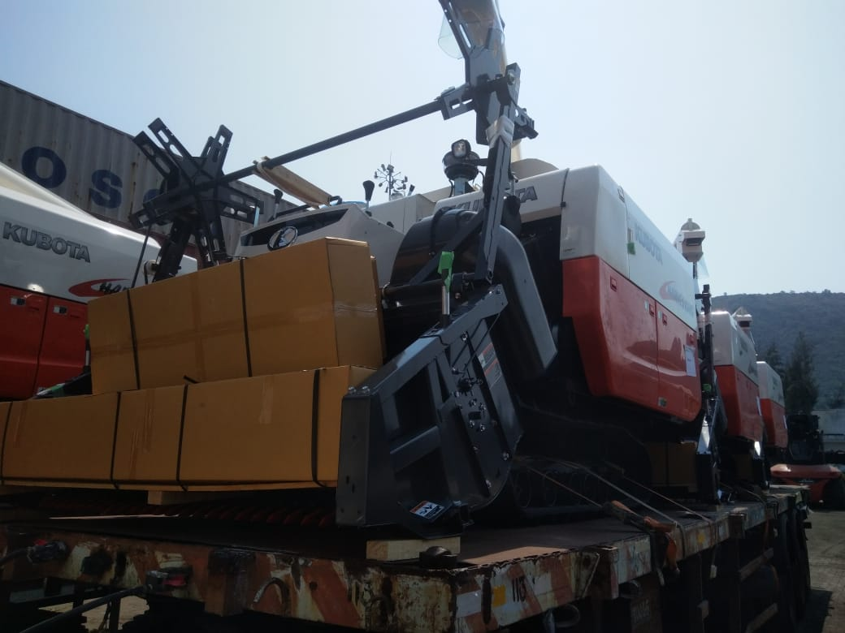
PROJECT CARGO

Slide 12
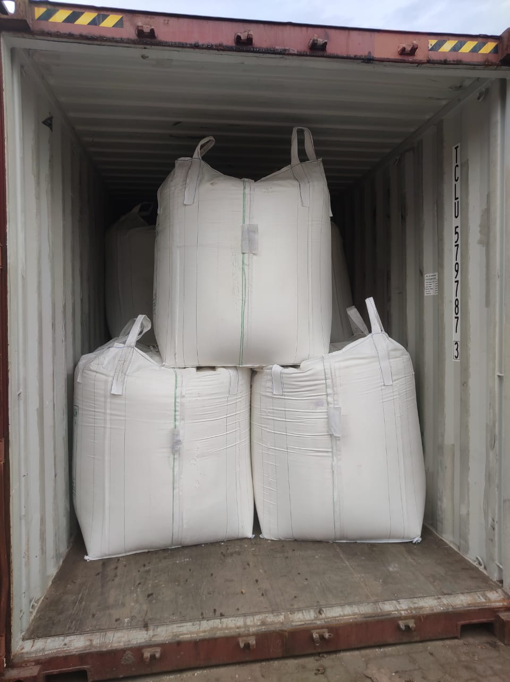
JUMBO BAGS

Slide 13
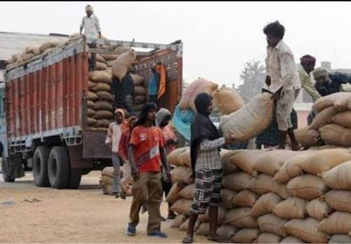
Handling of Cashew Nuts

Slide 14
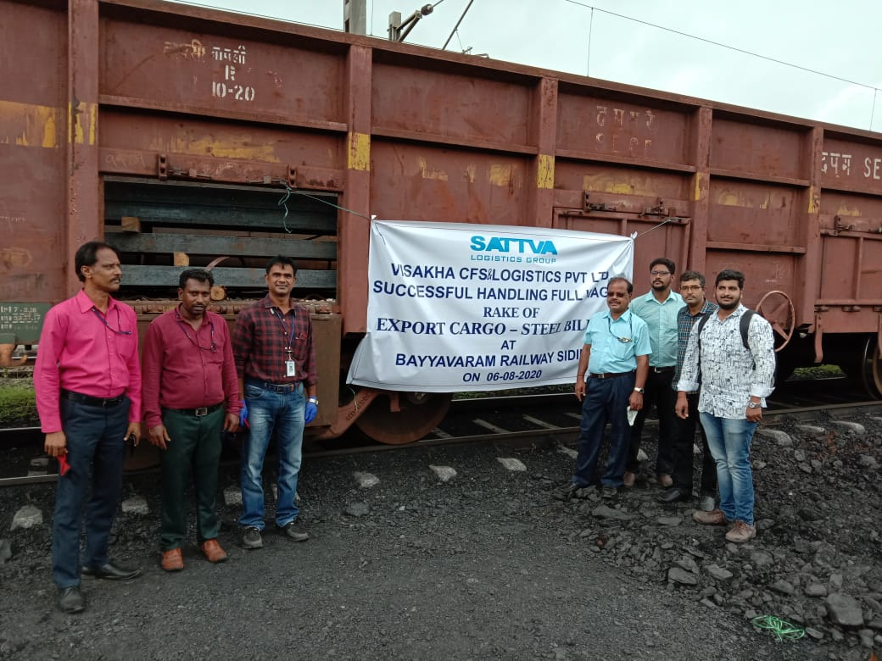

Slide 15

Major Agri imports through our CFS

Slide 16

Major Agri exports through our CFS

Slide 17
WAREHOUSING

Slide 18
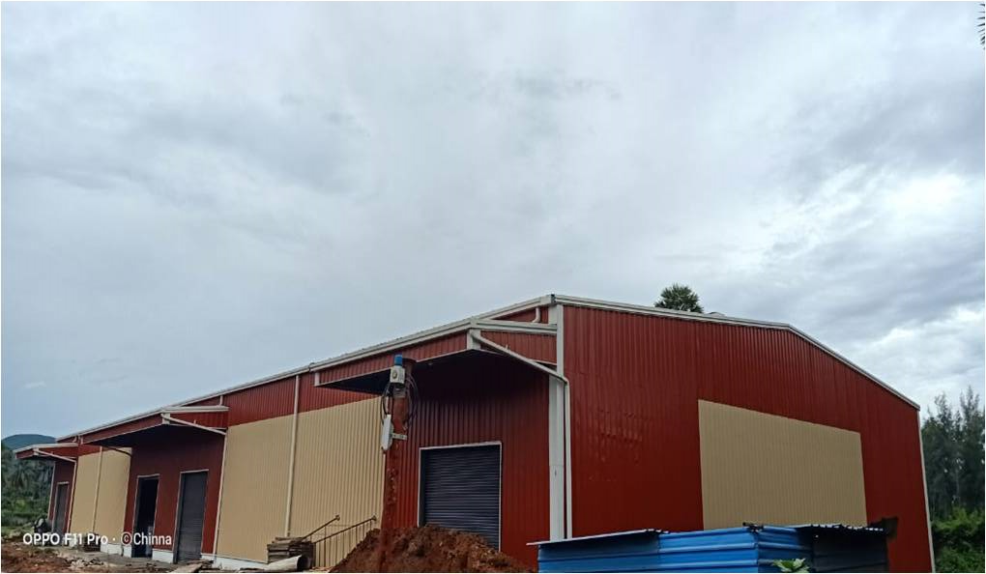

Slide 19
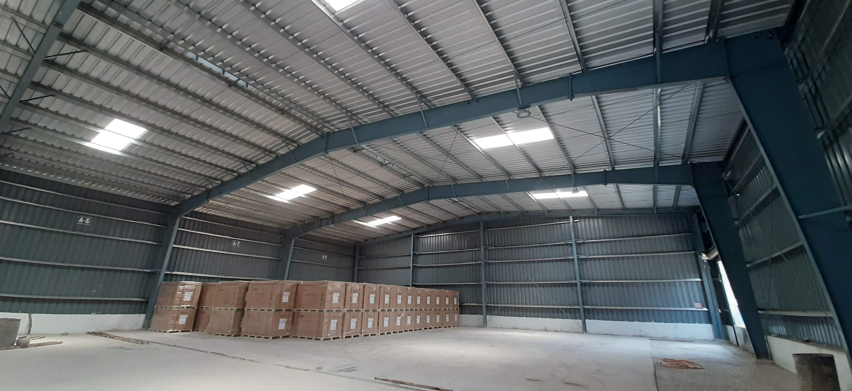

Slide 20
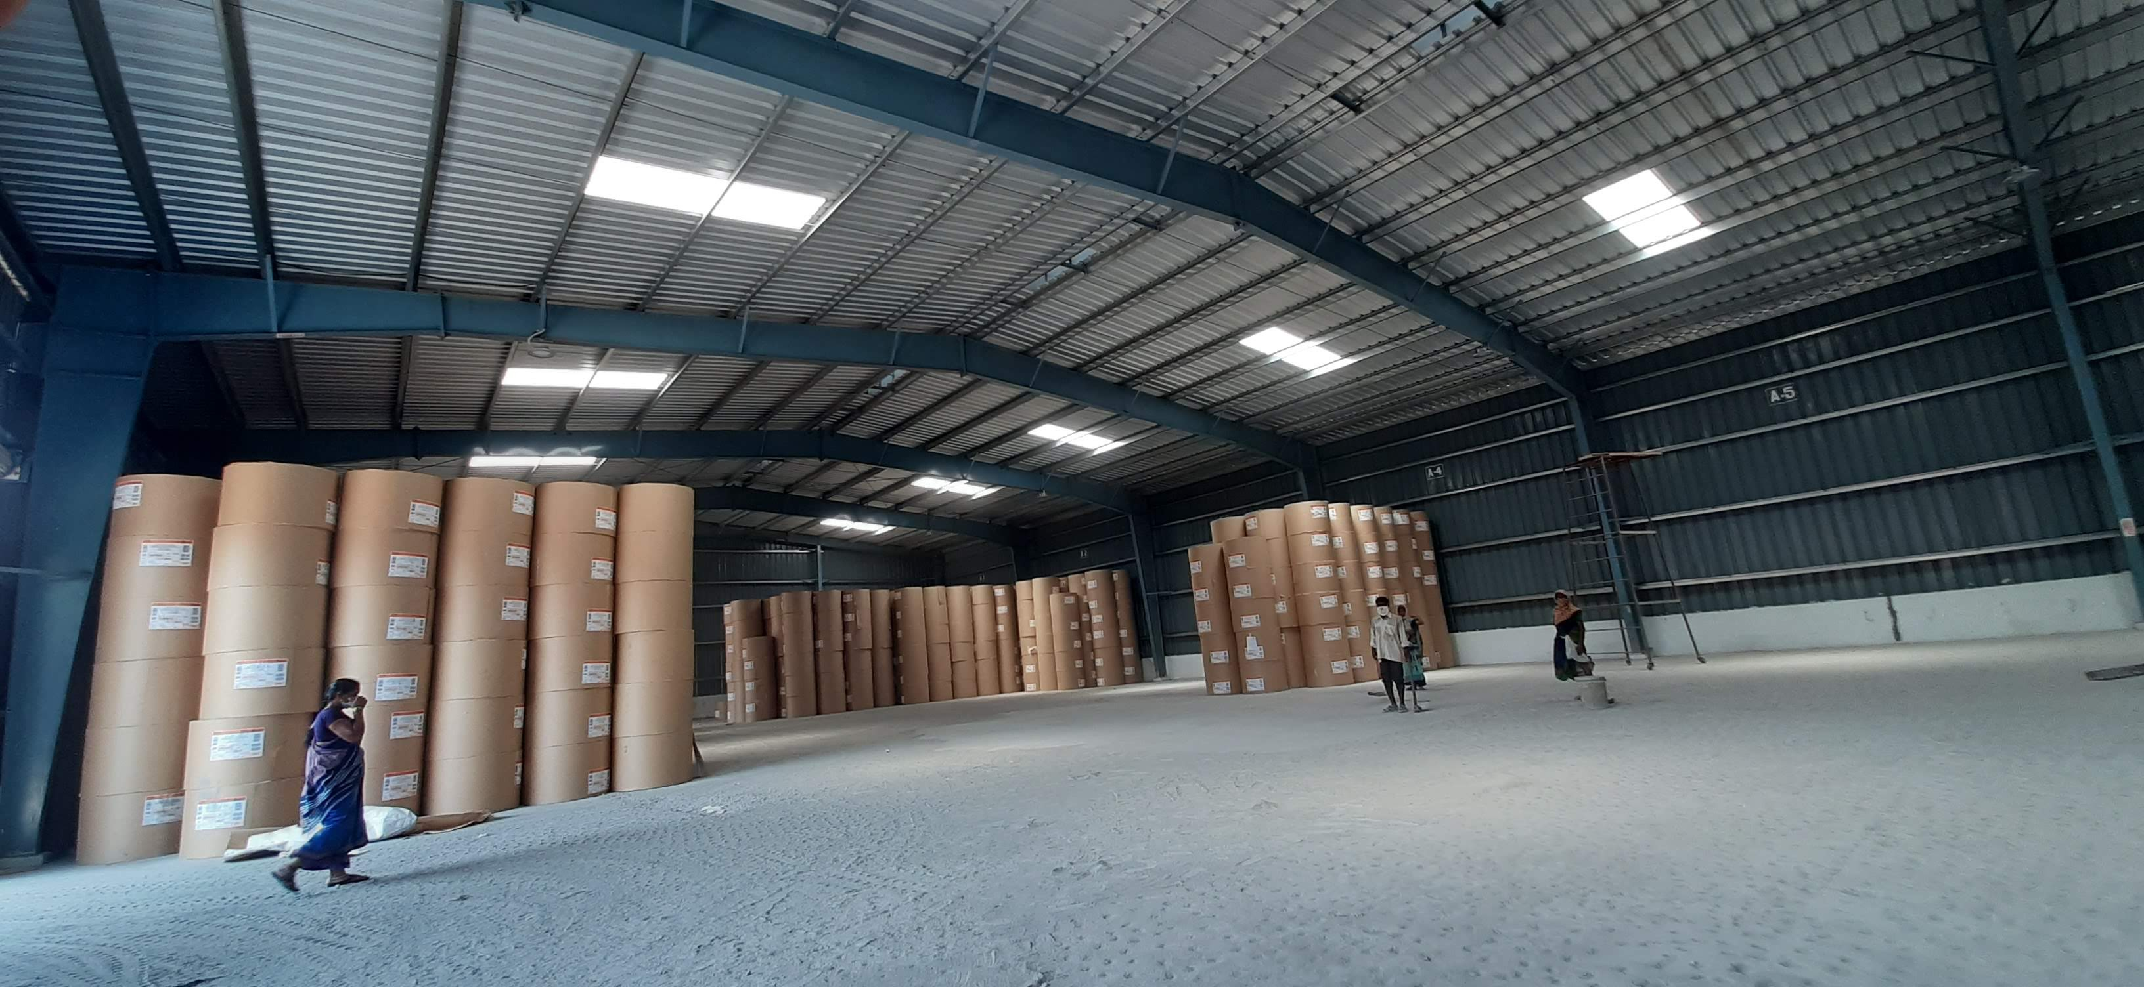

Slide 21
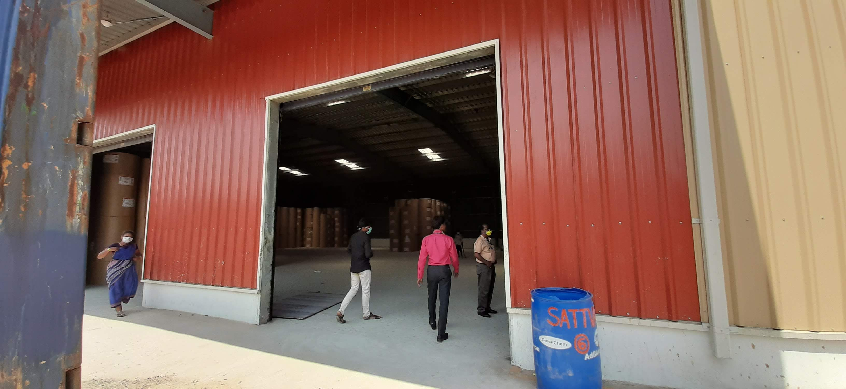
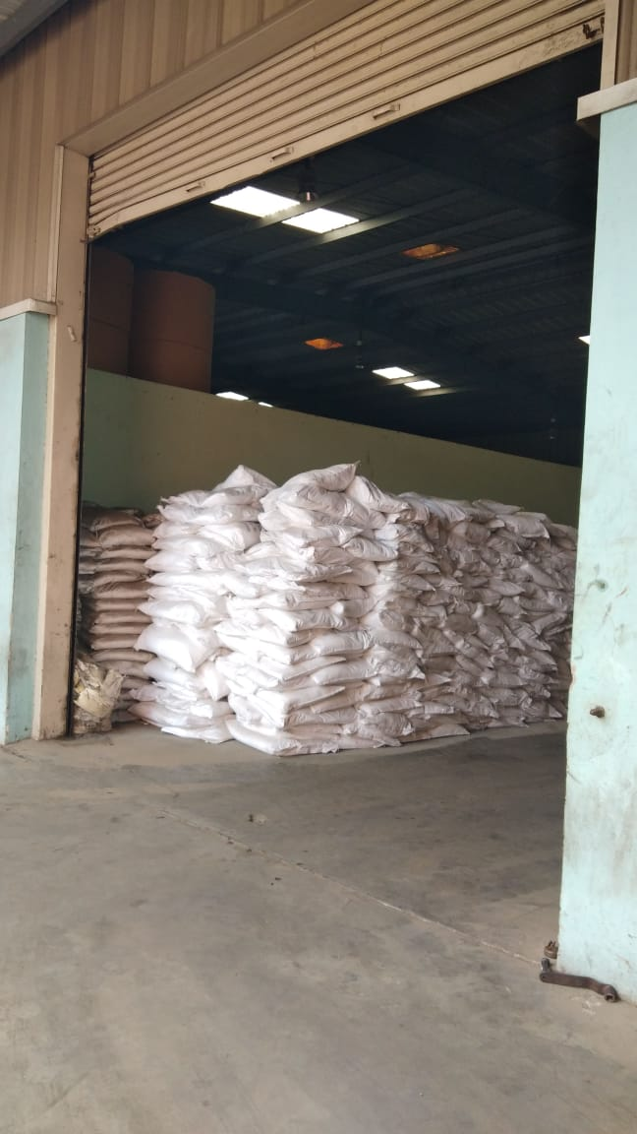

Slide 22
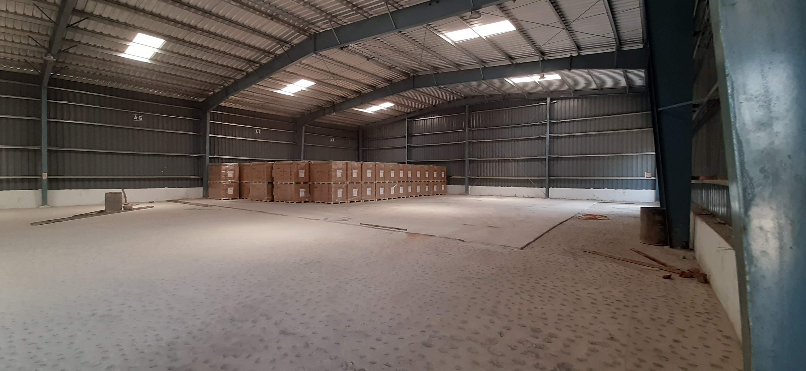

Slide 23
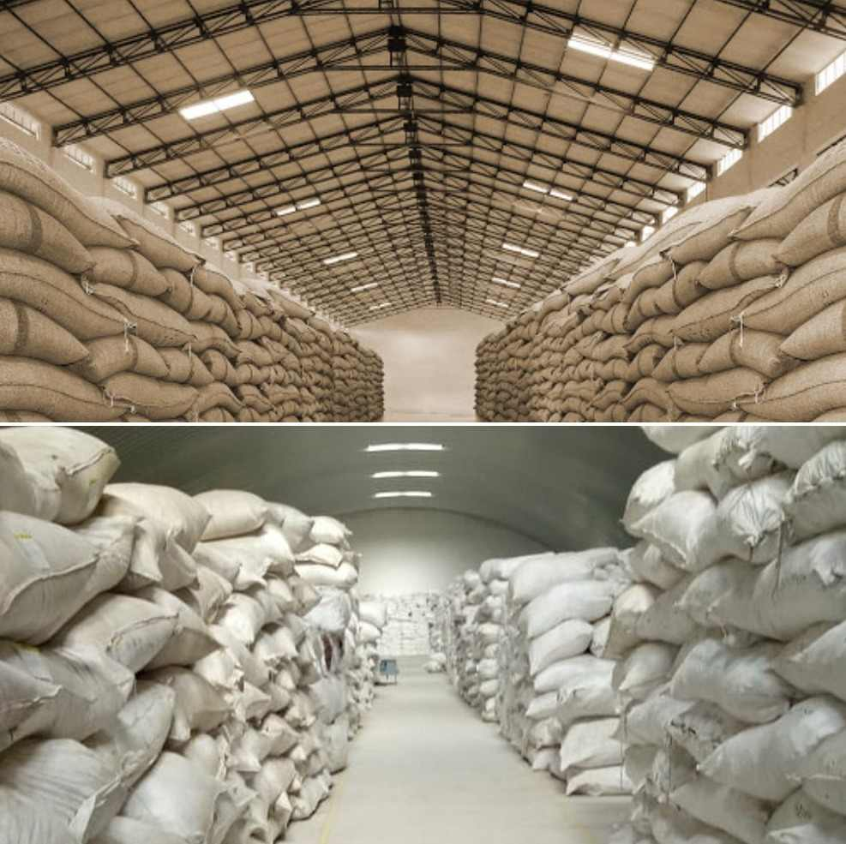

Slide 24


Slide 25
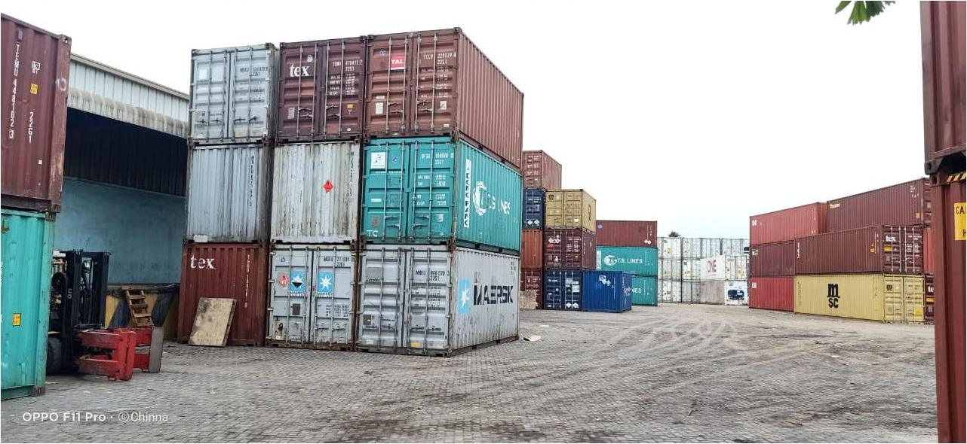
Empty Container Depot:

Slide 27


